Slide 1
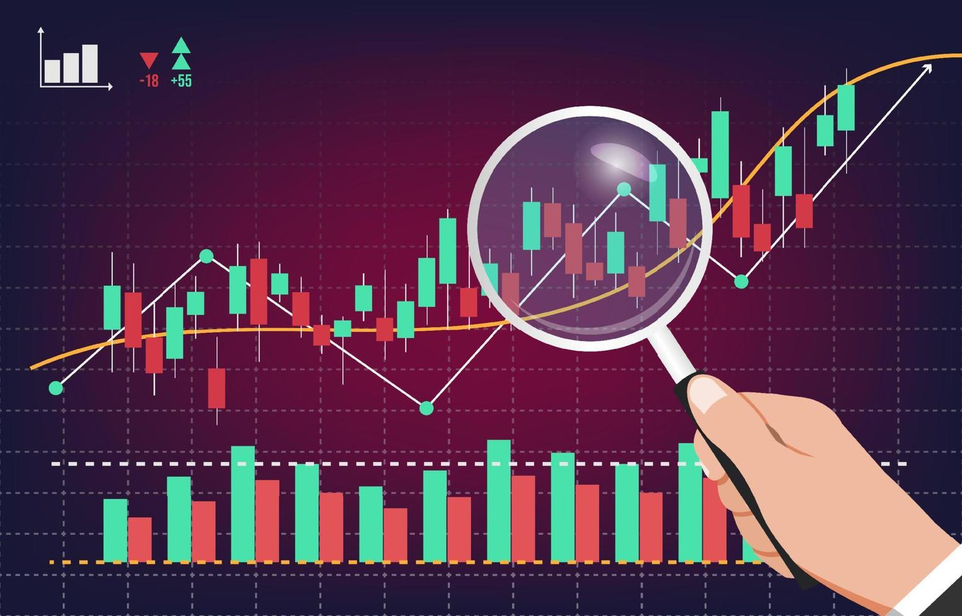
Stock Market Analysis
Project by – Sanjivani Jadhav

Slide 2
Project Overview
The primary objective of this project is to provide insights into the stock market performance of the selected major companies.
The Stock Market Analysis project aims to analyze historical stock market data, extract meaningful insights, and develop predictive models to assist investors in making informed decisions.
Through analysis, we aim to identify patterns, trends, and anomalies in the stock’s behaviour over time.
By doing so, we hope to make informed decisions regarding the stock purchases, sales, or holdings, potentially.
This project utilizes various technical indicators and financial metrics to assess stock trends, volatility, and potential investment opportunities.

Slide 3
Objectives
To analyze stock price movements using historical data.
To evaluate stock performance with key technical indicators
(e.g., Moving Averages, RSI, MACD, Bollinger Bands).
To identify patterns in stock trends and potential trading signals.
To assess stock volatility and risk using Beta and PE Ratio.
To provide visualizations and statistical summaries for better decision-making.
To implement predictive modeling for stock price forecasting.

Slide 4
Average Daily Trading Volume
Most Volatile Stocks
Stocks with Highest Dividend and Lowest Dividend
Highest and Lowest P/E Ratios
Stocks with Highest Market Cap
Stocks Near 52 Week High
Stocks Near 52 Week Low
Stocks with Strong Buy Signals and stocks with Strong Selling Signal
KPI’s

Slide 5
Average Daily Trading Volume
This graph represents the average number of shares traded per day
for five major tech stocks:
Facebook (FB) has the highest average daily trading volume
(~5.527M shares). This suggests that FB is the most liquid among the
stocks shown, meaning it is easier to buy or sell large quantities
without significantly affecting the price.
Apple (AAPL) has the lowest trading volume (~5.495M shares).
While still highly liquid, it has slightly lower trading activity compared
to the others.
Amazon (AMZN): ~5.524M share
Google (GOOGL): ~5.511M shares
Microsoft (MSFT): ~5.517M shares.
These stocks have similar trading volumes, showing a balanced level of liquidity and investor interest.
Market Implications:
Higher trading volumes indicate strong investor activity and confidence in the stock.
Stocks with lower trading volumes may have less price stability compared to those with higher volumes.

Slide 6
Most Volatile Stocks
This pie chart represents the Beta values of five major tech stocks and
their relative volatility compared to the market.
Microsoft (MSFT) has the highest Beta value (1.0023), indicating it is
slightly more volatile than the market.
Apple (AAPL) follows closely with a Beta of 1.0022.
Facebook (FB) has the lowest Beta (0.9987), meaning it is slightly less
volatile than the overall market.
Google (GOOGL) has a Beta of 1.0000, indicating its volatility is perfectly
in line with the market.
Amazon (AMZN) has a Beta of 1.0014, meaning it is slightly more volatile
than the market but still relatively stable.
Investment Implications:
Higher Beta stocks (e.g., MSFT, AAPL) may provide higher returns but come with increased risk.
Lower Beta stocks (e.g., FB) are less risky but may offer lower returns during market upswings.
Google (GOOGL) being at 1.0000 suggests it moves almost identically to the market.

Slide 7
Stocks with Highest Dividend and Lowest Dividend
This graph represents the dividend yield or dividend payout ratio for
five major tech stocks.
Dividends are payments made to shareholders as a return on
investment.
Higher dividend values (like AMZN and MSFT) indicate these
companies prioritize returning profits to shareholders.
Lower dividend values (like GOOGL) suggest the company reinvests
more into growth and expansion rather than distributing earnings as
dividends.
Investment Implications:
Dividend-seeking investors may prefer AMZN and MSFT since they provide better returns through dividends.
Growth-oriented investors might lean towards GOOGL and FB, as they reinvest profits for future expansion.
AAPL provides a balanced approach, offering a reasonable dividend while still focusing on growth.

Slide 8
Stocks with Highest Market Cap
This graph represents the market cap of five major tech companies.
Amazon (AMZN) has the highest market cap at 4,437.48M.
This suggests it has the greatest total value of its outstanding shares
compared to the others.
Google (GOOGL) has the lowest market cap at 4,392.88M. It is still a
massive company, but compared to the others, it has the smallest valuation.
Facebook (FB): 4,423.18M, Microsoft (MSFT): 4,421.54M,
Apple (AAPL): 4,407.79M.. These companies have relatively similar market
caps, indicating strong investor confidence and high valuation.
Higher market cap suggests greater investor confidence, higher revenue, and industry dominance.
Lower market cap does not mean the company is weak, but it may have fewer outstanding shares or a lower stock price compared to its peers.
Investment Implications:
Investors often use market cap to determine company size and stability.
Large-cap stocks like these tend to be more stable and less risky than mid-cap or small-cap stocks.
Market cap helps compare companies in the same industry and assess their overall market position.

Slide 9
Highest and Lowest P/E Ratios
This graph represents the valuation of major tech stocks.
Apple (AAPL) has the highest PE ratio at 63.61. This suggests investors are
willing to pay a higher price for each dollar of earnings Apple generates.
Facebook (FB) has the lowest PE ratio at 62.38. This indicates that, relative
to its earnings, Facebook's stock is cheaper than the others.
Amazon (AMZN): 63.27, Google (GOOGL): 62.84, Microsoft (MSFT): 62.44.
These companies have similar PE ratios, indicating that their stocks are
valued similarly relative to earnings.
A higher PE ratio suggests that investors expect higher future growth and
earnings.
A lower PE ratio (like FB) may indicate that the stock is undervalued or that the company has lower expected growth.
Investment Implications:
Growth investors might be attracted to stocks with higher PE ratios, expecting future earnings growth.
Value investors might prefer stocks with lower PE ratios, believing they are undervalued compared to earnings potential.
Comparing PE ratios across the same industry (tech sector) helps assess which stocks are overvalued or undervalued.

Slide 10
Stocks Near 52 Week High
This graph represents the recent stock prices of major tech companies.
Facebook (FB) is closest to its 52-week high (1,509.28). This suggests
strong momentum and investor confidence in FB.
Amazon (AMZN) is the lowest among the stocks (1,509.10). It is slightly
below the others, which may indicate a recent dip in performance.
Microsoft (MSFT) is rebounding (1,509.19). It is showing an upward
trend, meaning it is recovering towards its 52-week high.
A stock trading near its 52-week high often suggests strength and
potential breakout opportunities.
If a stock is consistently near its 52-week high, it may indicate bullish
momentum and investor confidence.
Investment Implications:
Breakout Potential: Stocks at or near their 52-week highs can indicate further upside potential if they continue to rise.
Profit-taking Risk: Some investors may sell stocks at highs, leading to short-term pullbacks.
Market Sentiment: If all major tech stocks are trading close to their highs, it signals overall market strength in the tech sector.

Slide 11
Stocks Near 52 Week Low
This graph represents how close major tech stocks are to their lowest
price in the past 52 weeks.
Amazon is the furthest from its 52-week low (91.893). This suggests that
it has seen a strong recovery & is not near its lowest price.
Google is the closest to its 52-week low (91.398). This indicates hat it
has been struggling and is near its lowest price point of the year.
A stock trading near its 52-week low can indicate bearish sentiment or
a potential buying opportunity.
Stocks far from their 52-week lows may have stronger momentum and
investor confidence.
If a stock is consistently near its 52-week low, it may indicate long-term
underperformance or negative market sentiment.
Investment Implications:
Buying Opportunity: Stocks near their 52-week low may be undervalued, offering potential for future gains if they recover.
Weakness Concerns: If a stock remains close to its low, it may indicate continued struggles or declining investor confidence.
Market Trend Indicator: If multiple stocks are near their lows, it may suggest sector-wide weakness in tech stocks.

Slide 12
Stocks with Strong Buy and Selling Signals
This graph based on MACD and RSI helps traders identify potential
buying and selling opportunities using technical indicators.
Stocks with Strong Buy Signals (Positive MACD & RSI < 45)
AMZN (+26.7K) and AAPL (+26.5K) show strong buying signals. Their
MACD is above the signal line (bullish trend) & their RSI is likely below
45, meaning they might be undervalued or oversold, leading to potential
price rebounds.
Stocks with Strong Selling Signals (Negative MACD & RSI ≥ 69)
FB (-39.8K) & GOOGL (-23.5K) show strong selling signals. Their MACD
values are negative, meaning a bearish short-term trend. Their RSI is
likely 69 or higher, indicating an overbought condition, suggesting a
possible price decline.
Neutral or Mild Buy Signal
MSFT (+8.5K) has a weaker buy signal than AMZN & AAPL, meaning it’s bullish but with less momentum.
Investment Insights Based on the Graph:
Potential Buy Stocks: AMZN & AAPL (Strong Bullish Signals)
Potential Sell Stocks: FB & GOOGL (Bearish Signals)
Neutral or Weak Buy: MSFT (Mild Bullish Trend)

Slide 13
Conclusion
This project provides a comprehensive analysis of stock market trends using key financial indicators.
By evaluating stocks based on trading volume, volatility, dividends, valuation ratios, market capitalization, and technical indicators, we identified potential investment opportunities and risks.
Liquidity & Trading Volume
Stocks with high average daily trading volume demonstrate strong liquidity, ensuring ease of buying and selling without significant price fluctuations.
Lower trading volume stocks may experience higher bid-ask spreads and potential price swings.
Market Volatility & Beta
Highly volatile stocks (high beta) show strong price sensitivity to market movements, making them attractive to aggressive traders seeking short-term gains.
Low-beta stocks provide stability, often preferred by risk-averse investors.
Dividend Analysis
Stocks with high dividend payouts are ideal for income-focused investors seeking stable returns.
Low or no dividend stocks tend to be growth-oriented, reinvesting earnings into expansion rather than distributing profits to shareholders.

Slide 14
Valuation (P/E Ratio)
High P/E ratio stocks indicate strong expected future earnings growth and are considered growth stocks.
Low P/E ratio stocks suggest potential undervaluation and are attractive for value investors looking for long-term opportunities.
Market Capitalization & Stability
Stocks with the largest market cap offer stability and liquidity but may not provide high growth opportunities.
Smaller-cap stocks can deliver higher growth but often carry higher risk and volatility.
52-Week High & Low Stocks
Stocks near their 52-week high indicate recent bullish performance and strong investor confidence but may face resistance.
Stocks near their 52-week low may be under negative sentiment; however, they could present value opportunities if supported by strong fundamentals.
Technical Indicators (MACD & RSI) for Buy & Sell Signals
Strong buy signals are identified when MACD is positive and RSI < 45, indicating oversold conditions and potential price rebound.

Slide 15
2. Strong sell signals occur when MACD is negative and RSI ≥ 69, suggesting overbought conditions and possible price correction.
Investment Implications:
Growth Investors should focus on high P/E, low-dividend, and high-volatility stocks for capital appreciation.
Value Investors can explore low P/E, high-dividend, and stocks near 52-week lows for potential undervalued opportunities.
Income Investors should prioritize high-dividend, stable, and large-market-cap stocks for steady returns.
Traders & Momentum Investors can leverage RSI and MACD signals to capitalize on short-term price trends.
This analysis serves as a foundation for making data-driven investment decisions. By integrating fundamental and technical analysis, investors can develop strategies aligned with their risk tolerance and financial goals. Regular monitoring of market trends and macroeconomic factors is essential for adapting to changing market conditions.

Slide 16
Expected Outcomes
A comprehensive analysis of stock price trends and volatility.
Identification of optimal buying and selling points based on indicators.
A risk assessment framework for better portfolio management.
Predictive insights into future stock movements.
An interactive dashboard for stock data visualization.
This project will serve as a valuable tool for traders, investors, and financial analysts to make data-driven investment decisions.

Slide 17
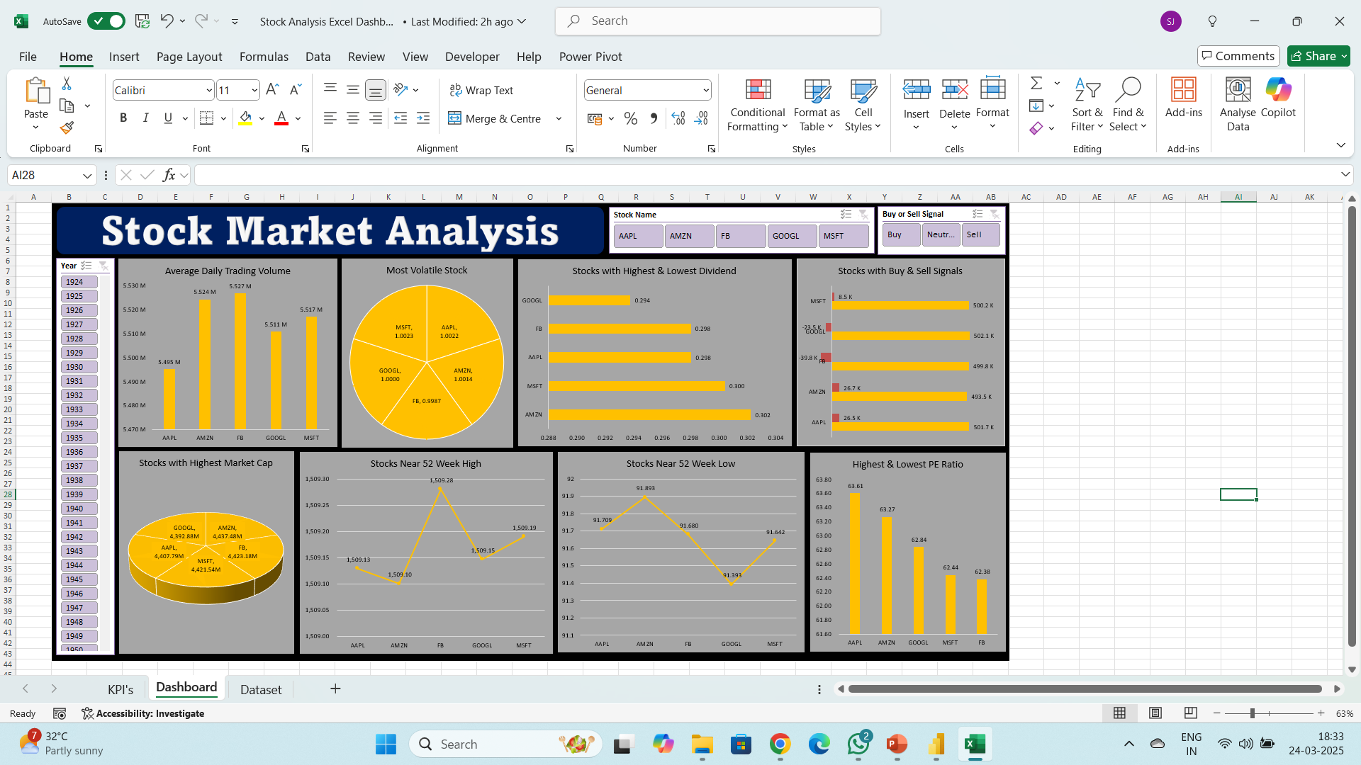
Excel Dashboard

Slide 18
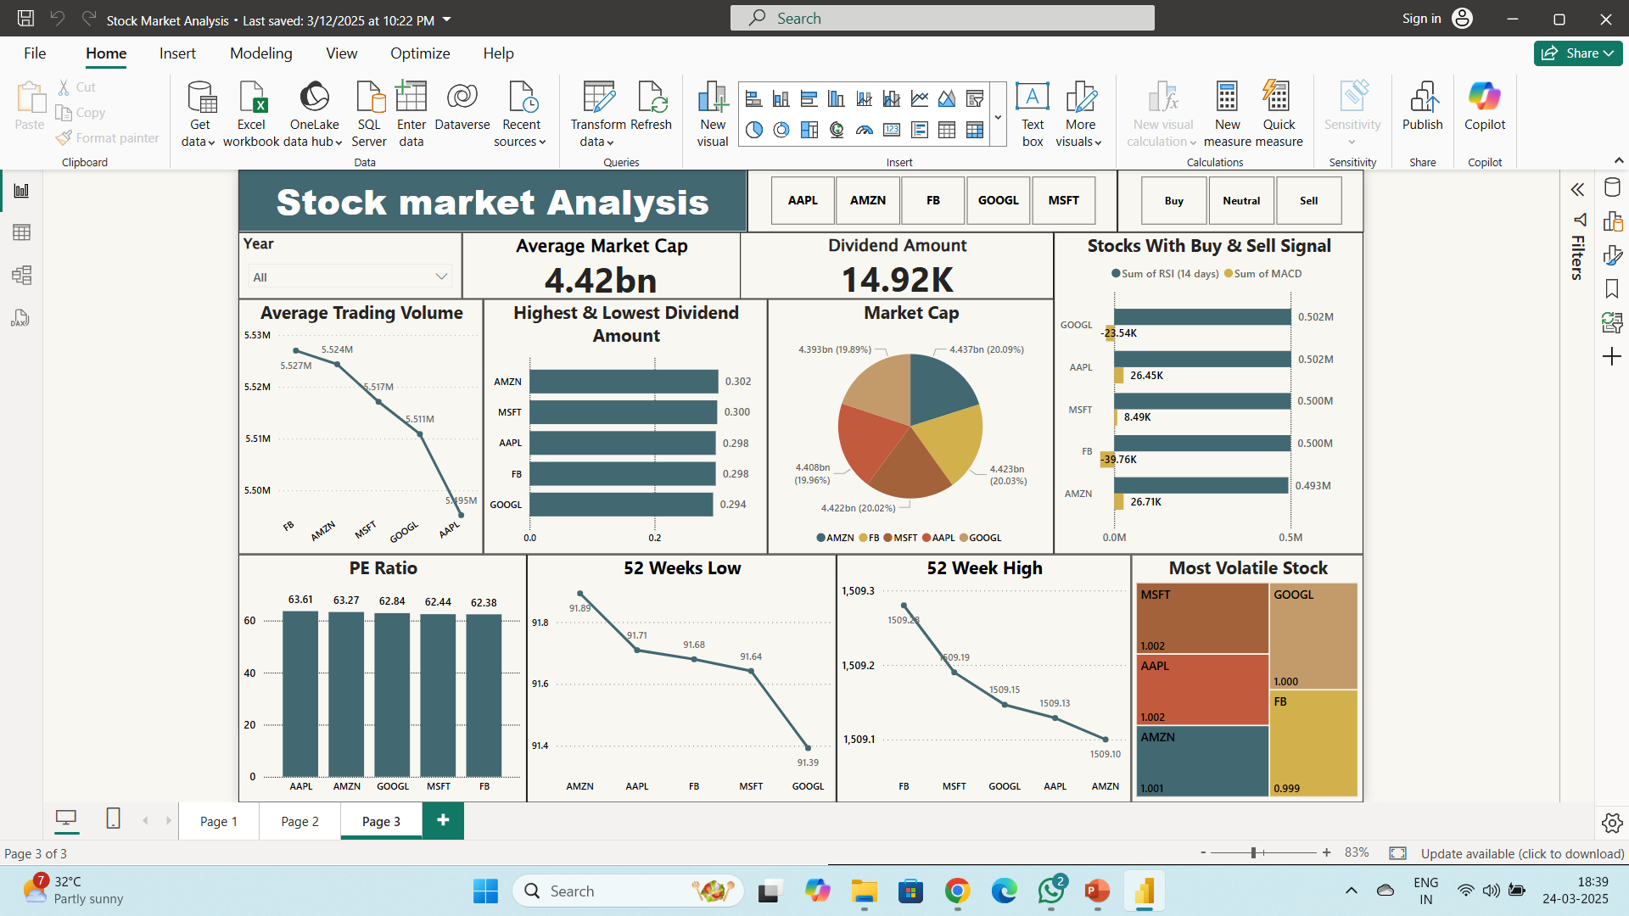
Power BI Dashboard

Slide 19
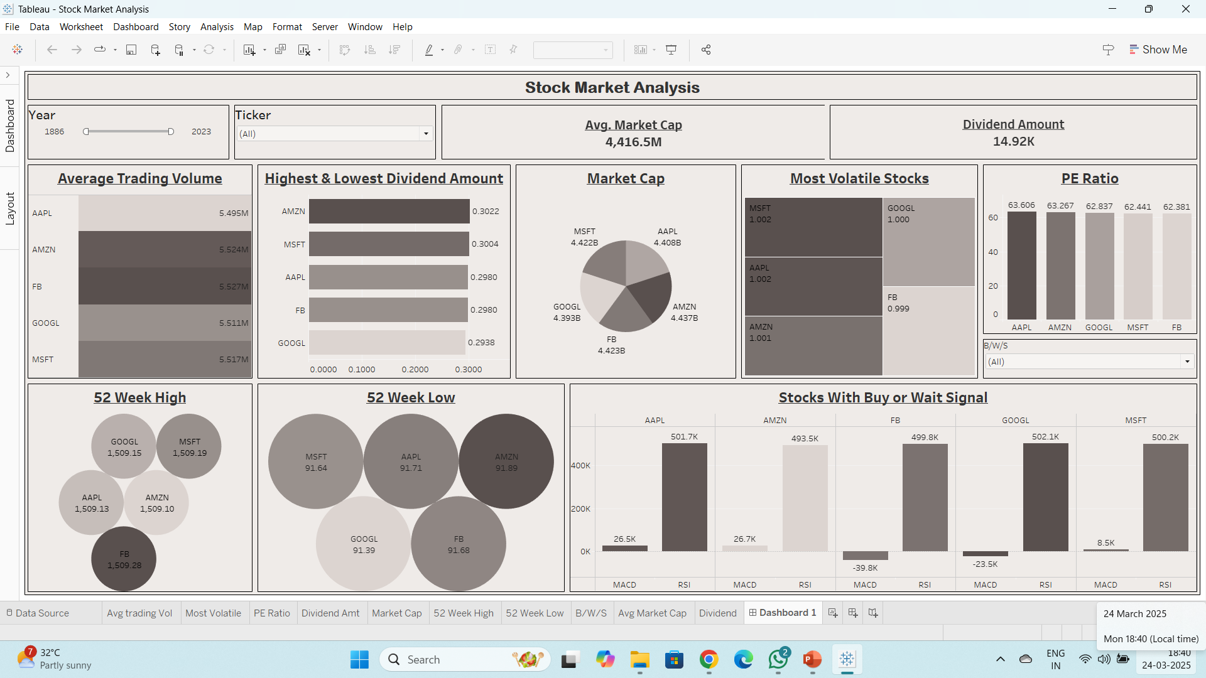
Tableau Dashboard

Slide 20
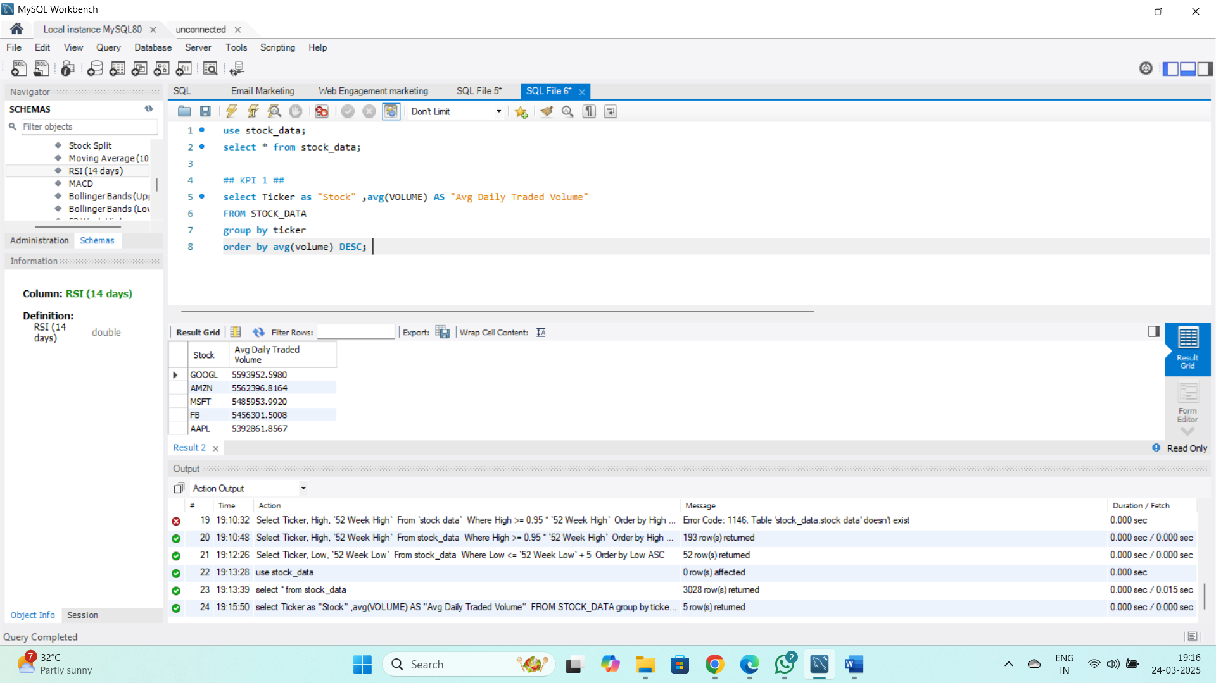
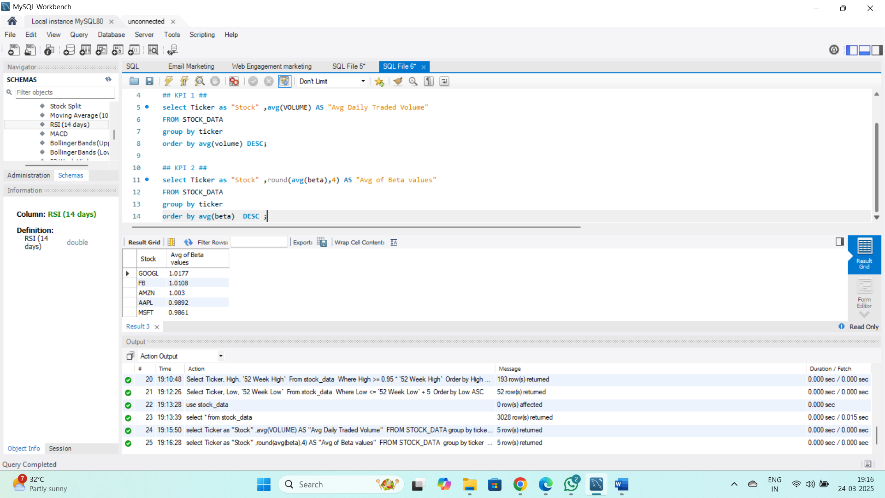
SQL Queries and Output

Slide 21
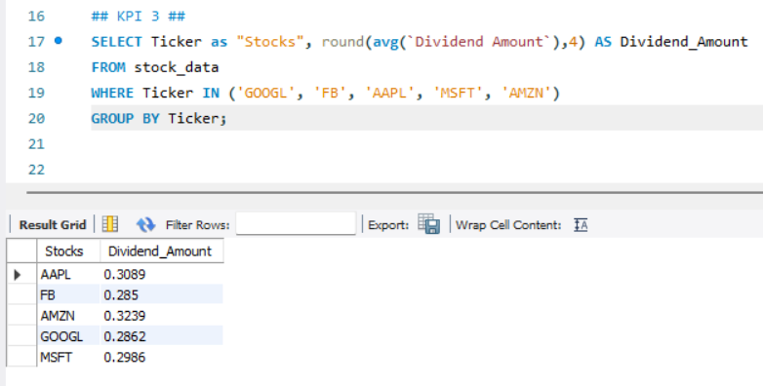

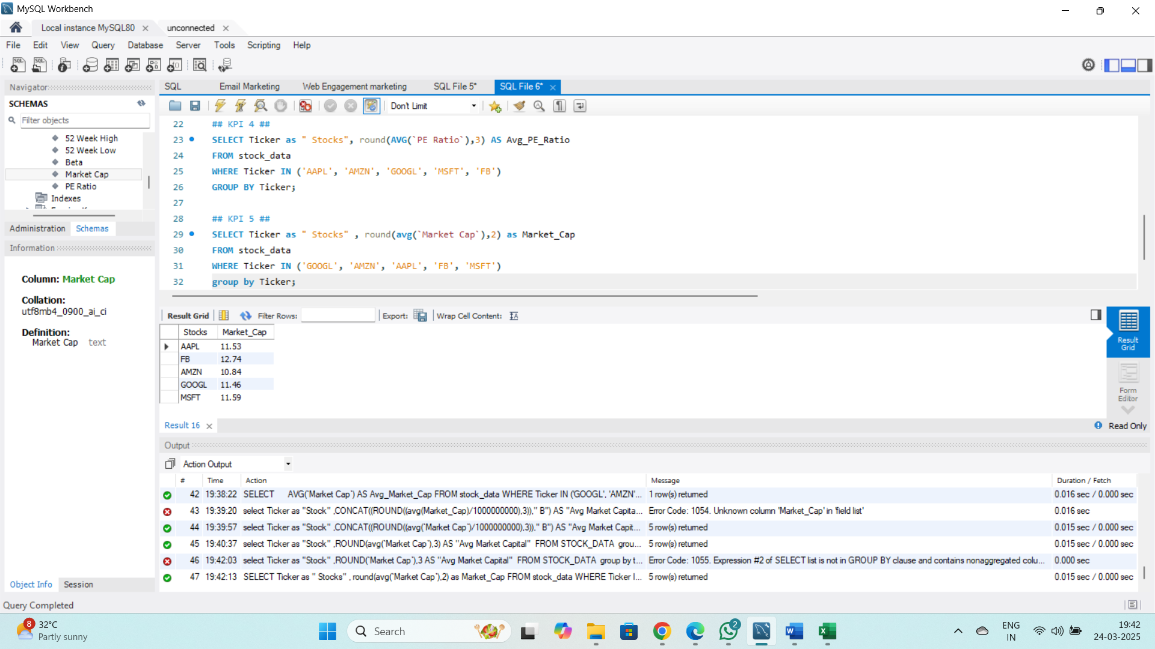
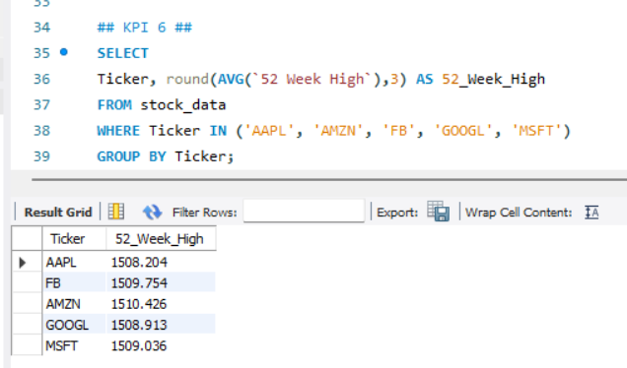

Slide 22
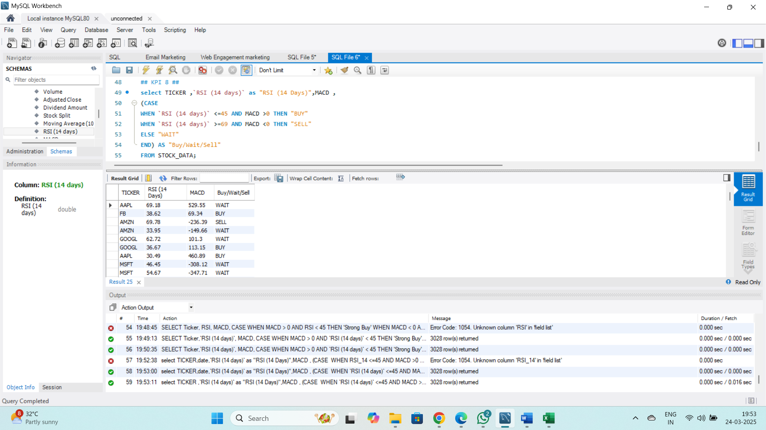
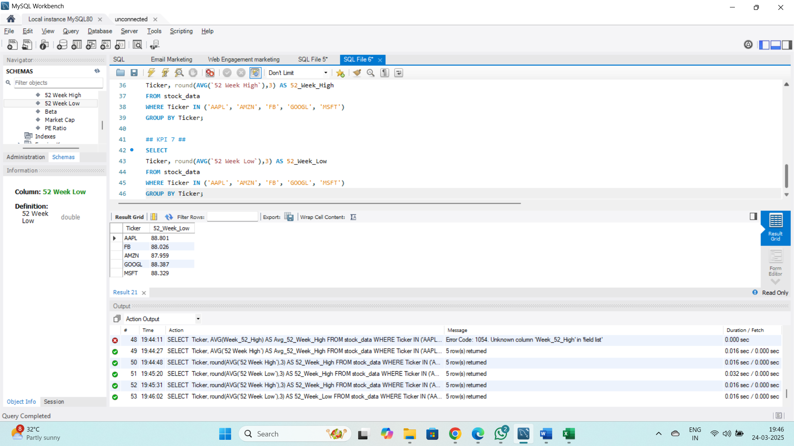

Slide 23


